Slide 1
Silverlight Introduction
Jon Galloway
Vertigo Software
ASP.NET MVP, Silverlight Insider

Slide 2
Schedule
8:30 AM – 9:30 AM (Jon Galloway)
Silverlight Intro\Overview
9:45 – 11:00 AM (Jon Galloway)
XAML & Expression Tools
11:15 - 12:15 PM (Tim Heuer)
Animation, Audio, Video
12:15 PM – 1:15 PM
Lunch Provided
1:15 PM – 2:30 PM (Tim Heuer)
Silverlight Controls
2:45 PM – 4:00 PM (Robert Altland)
Silverlight and Data
4:15 PM – 5:00 PM (Robert Altland)
Silverlight Development Process (Team Development, Debugging, Testing, Deployment)
5:00 PM – 5:15 PM
Closing and Giveaways

Slide 3
Introduction to Silverlight
What
Where
How
Why

Slide 4
What
WPF/E – Windows Presentation Foundation Everywhere
WPF
As in the latest and greatest in Windows desktop development
Smaller, of course - <5 MB
Layout / Media
Including .NET, of course

Slide 5





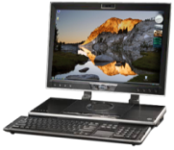






Microsoft .NET Application Platform Deliver applications across the UX Continuum
Consistent Tools & Application Model
Develop
Deploy
Design
Browser
User Experience Continuum
Client

Slide 6
Where
Everywhere
Cross-browser
IE, Firefox, Safari
Plus Google Chrome (kind of)
Cross-platform
Windows
Mac
Linux (Moonlight – latest is Moonlight 2 Beta 5)
Plus Windows Mobile 7 (http://bit.ly/19YFcN)
Plus Silverlight for Windows Embedded (http://bit.ly/YF7LP)

Slide 7
How? Silverlight 3 Hello World Demo

Slide 8
How
Standard browser plugin
<object> tag
Object fallback
No cheating
Standard HTML
Javascript not required (strictly speaking)
DOM bridge
http://silverlight.net/getstarted/

Slide 9
Why?
Part 1: Silverlight 3 Parade of Awesomeness
Part 2: But why Silverlight?

Slide 10
Silverlight 3 Parade of Awesomeness

Slide 11




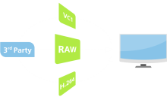
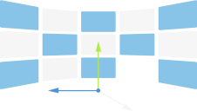
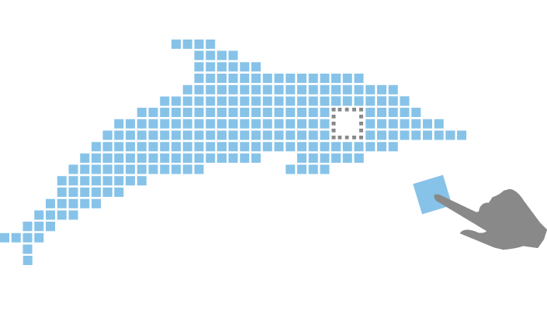
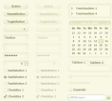
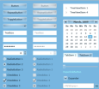











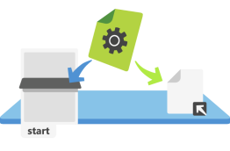







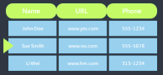

Silverlight 3 Themes
Support for Higher Quality Video & Audio
Empowering Rich Experiences
Improving RIA Productivity
Out of Browser Capabilities
Design Tooling
Notes:
New Features in Silverlight 3: Fully supported by Visual Studio and Expression Blend, highlights of new features and functionality of Silverlight 3 include: major media enhancements, out of browser support allowing Web applications to work on the desktop; significant graphics improvements including 3D graphics support, GPU acceleration and H.264 video support; and many features to improve RIA development productivity. Also, in order to fully integrate all the .NET developer tools, Visual Studio 2008, Visual Studio 2010 and Visual Web Developer Express will support a fully editable and interactive designer for Silverlight. New features in Silverlight 3 include:

Slide 12



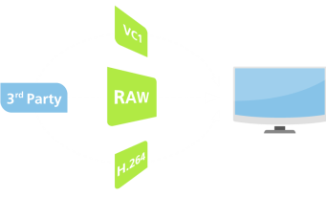

Silverlight 3 New Capabilities : Media
Support for Higher Quality Video and Audio
Smooth Streaming
More Format Choices
Media
Media
Graphics
Full Screen HD Playback
Extensible Media Formats
Dev Productivity
Out of Browser
Design Tooling
Industry Leading Content Protection
Notes:
With support for native H.264/Advanced Audio Coding (AAC) Audio, live and on-demand IIS7 Smooth Streaming, full HD (720p+) playback, and an extensible decoder pipeline, Silverlight 3 brings rich, full-screen, stutter-free media experiences to the desktop.

Slide 13

Silverlight 3 New Capabilities : Media
Support for Higher Quality Video and Audio
IIS7 Smooth Streaming Live & On-Demand True HD 720p+
Media
Media
IIS Media Services (formerly IIS Media Pack) is an integrated HTTP media delivery platform, which features Smooth Streaming which dynamically detects and seamlessly switches, in real time, the video quality of a media file delivered to Silverlight based clients depending on local bandwidth and CPU conditions.
Graphics
Dev Productivity
Out of Browser
Design Tooling
Notes:
Live and on-demand true HD (720p+) IIS7 Smooth Streaming. IIS Media Services (formerly IIS Media Pack), an integrated HTTP media delivery platform, features Smooth Streaming which dynamically detects and seamlessly switches, in real time, the video quality of a media file delivered to Silverlight based on local bandwidth and CPU conditions.

Slide 14
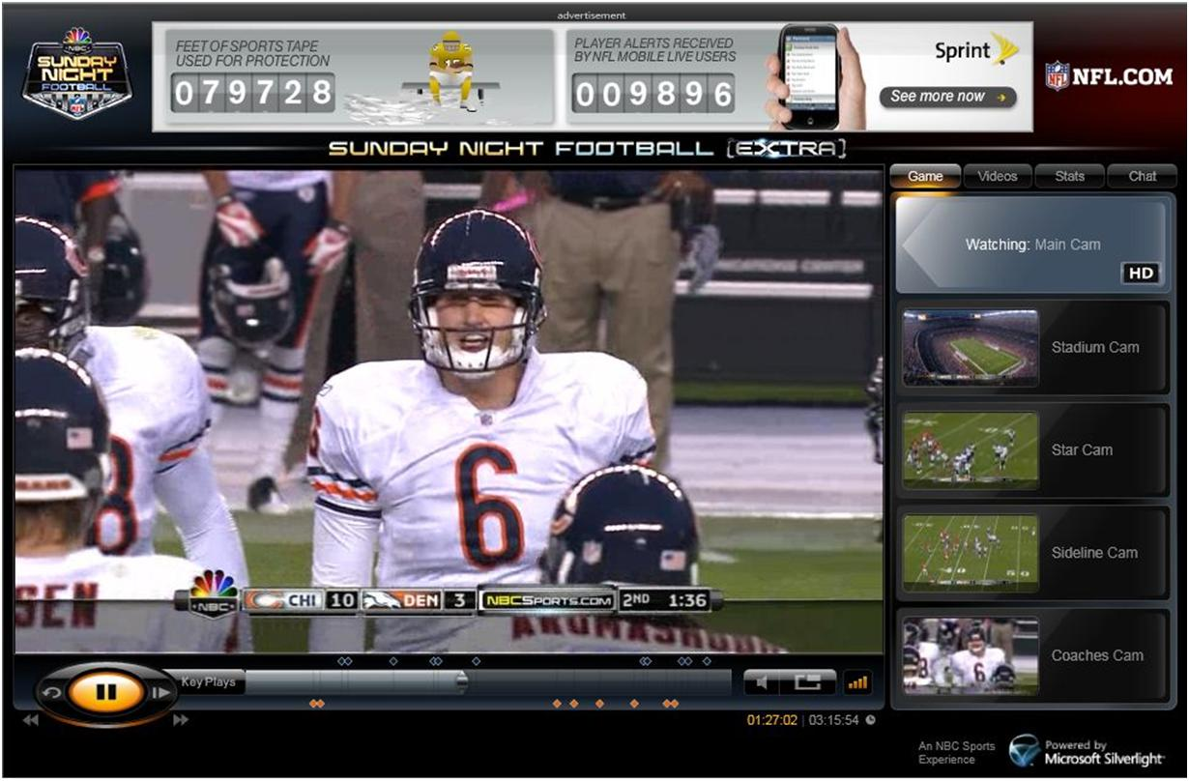
SmoothHD – Sunday Night Football

Slide 15
SmoothHD
Best video possible for each person
No buffering
http://snfextra.nbcsports.com/
http://blogs.vertigo.com/personal/bobc/Blog/archive/2009/09/10/get-ready-for-sunday-night-football.aspx
http://www.iis.net/media/experiencesmoothstreaming

Slide 16
Silverlight 3 New Capabilities : Media
Support for Higher Quality Video and Audio
More Format Choices
Media
Media
In addition to native support for VC-1/WMA, Silverlight 3 now offers native support for H.264 and AAC, giving content distributors a choice of widely supported industry formats
Graphics
Dev Productivity
Out of Browser
Design Tooling
Notes:
More format choice. In addition to native support for VC-1/WMA, Silverlight 3 now offers users native support for MPEG-4-based H.264/AAC Audio, enabling content distributors to deliver high-quality content to a wide variety of computers and devices.

Slide 17

Silverlight 3 New Capabilities : Media
Support for Higher Quality Video and Audio
True HD Playback in Full Screen
Media
Media
Silverlight 3 leverages graphics processor unit (GPU) hardware acceleration to deliver true full-screen 720p+ HD video playback
Graphics
Dev Productivity
Out of Browser
Design Tooling
Notes:
True HD playback in full-screen. Leveraging graphics processor unit (GPU) hardware acceleration, Silverlight experiences can now be delivered in true full-screen HD (720p+).

Slide 18
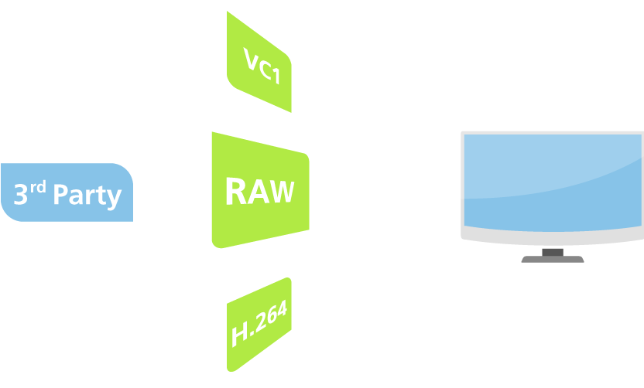
Silverlight 3 New Capabilities : Media
Support for Higher Quality Video and Audio
Extensible Media Format Support
Media
Media
With the new Raw AV pipeline, Silverlight can support a wide variety of third-party codecs. Audio and video can be decoded outside the runtime and passed to Silverlight for rendering, extending format support beyond the native codecs.
Graphics
Dev Productivity
Out of Browser
Design Tooling
Notes:
Extensible media format support. With the new Raw AV pipeline, Silverlight can easily support a wide variety of third-party codecs. Audio and video can be decoded outside the runtime and rendered in Silverlight, extending format support beyond the native codecs.

Slide 19

Silverlight 3 New Capabilities : Media
Support for Higher Quality Video and Audio
Industry Leading Content Protection
Media
Media
Silverlight DRM, Powered by PlayReady Content Protection enables protected in-browser experiences using AES encryption or Windows Media DRM.
Graphics
Dev Productivity
Out of Browser
Design Tooling
Notes:
Industry leading content protection. Silverlight DRM, Powered by PlayReady Content Protection enables protected in-browser experiences using AES encryption or Windows Media DRM.

Slide 20
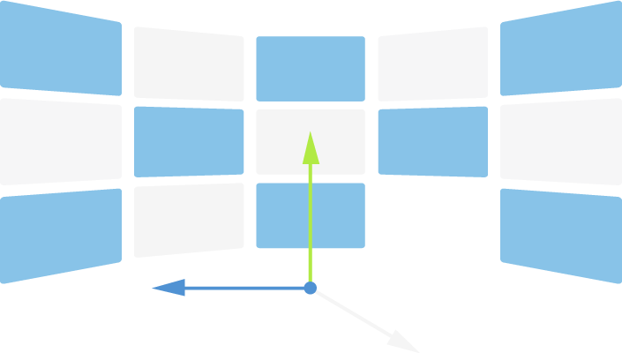

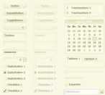

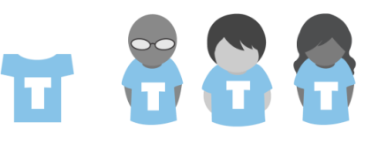

Silverlight 3 New Capabilities : Graphics
Empowering Rich Experiences
Perspective 3D Graphics
Bitmap Caching
Media
Graphics
Graphics
New Bitmap API
Themed App Support
Dev Productivity
Out of Browser
Design Tooling
Enhanced Control Skinning
Improved Text Rendering
Notes:
Empowering Richer Experiences. Silverlight 3 contains new 3D graphics, animation features, hardware accelerated effects and text improvements that enable designers and developers to create next generation Web visuals.

Slide 21
Silverlight 3 New Capabilities : Graphics
Empowering Rich Experiences
Perspective 3D Graphics & Animation Effects
Media
Silverlight 3 supports Perspective 3d Effects, so users can rotate or scale live content in space without writing any additional code, and Animation Effects such as spring and bounce, to make more natural movement.
Graphics
Graphics
Dev Productivity
Out of Browser
Design Tooling
Notes:
Perspective 3D Graphics. Silverlight 3 allows developers and designers to apply content to a 3D plane. Users can rotate or scale live content in space without writing any additional code. Other effects include creating a queue in 3D and transitions.
Animation Effects. Silverlight 3 provides new effects such as spring and bounce. These make animation more natural. Developers can also now develop their own mathematical functions to describe an animation

Slide 22

Silverlight 3 New Capabilities : Graphics
Empowering Rich Experiences
Bitmap Caching
Media
Silverlight 3 dramatically improves the rendering performance of applications by allowing users to cache vector content, text, and controls into bitmaps.
Graphics
Graphics
Dev Productivity
Out of Browser
Design Tooling
Notes:
Bitmap Caching. Silverlight 3 dramatically improves the rendering performance of applications by allowing users to cache vector content, text and controls into bitmaps. This feature is useful for background content and for content which needs to scale without making changes to its internal appearance.

Slide 23
Silverlight 3 New Capabilities : Graphics
Empowering Rich Experiences
New Bitmap API & Pixel Shader Effects
Media
Read and write pixel values directly to a bitmap with the new Bitmap API, and use the new Pixel Shader Effects such as blur and drop shadow or create your own unique effects that can be applied to any control or object in the application.
Graphics
Graphics
Dev Productivity
Out of Browser
Design Tooling
Notes:
New Bitmap API. With Silverlight 3, developers can now write pixels to a bitmap. Thus, they can build a photo editor to do red eye correction, perform edits on scanned documents or create specials effects for cached bitmaps from elements on the screen.
Pixel Shader effects. These software based effects include blur and drop shadow. In addition, you can also write your own effect. Effects can be applied to any graphical content. An example would be to make a button appear depressed on rollover you could use a drop shadow effect on the pressed visual state.

Slide 24
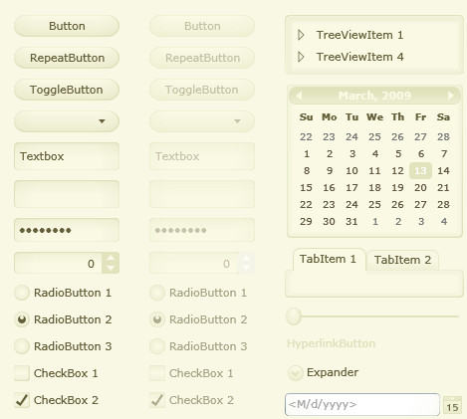
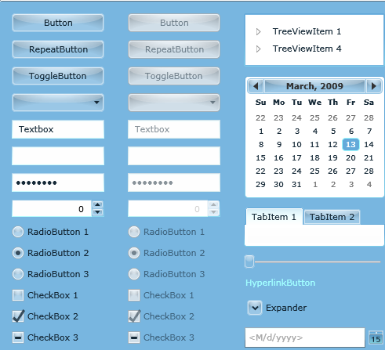
Silverlight 3 New Capabilities : Graphics
Empowering Rich Experiences
Themed Application Support
Media
Developers can now theme applications by applying styles to their controls and changing them at runtime. Additionally, styles can be cascaded by basing them on each other.
Graphics
Graphics
Dev Productivity
Out of Browser
Design Tooling
Notes:
Themed application support. Developers can now theme applications by applying styles to their Silverlight 3 applications and changing them at runtime. Additionally, developers can cascade styles by basing them on each other.

Slide 25
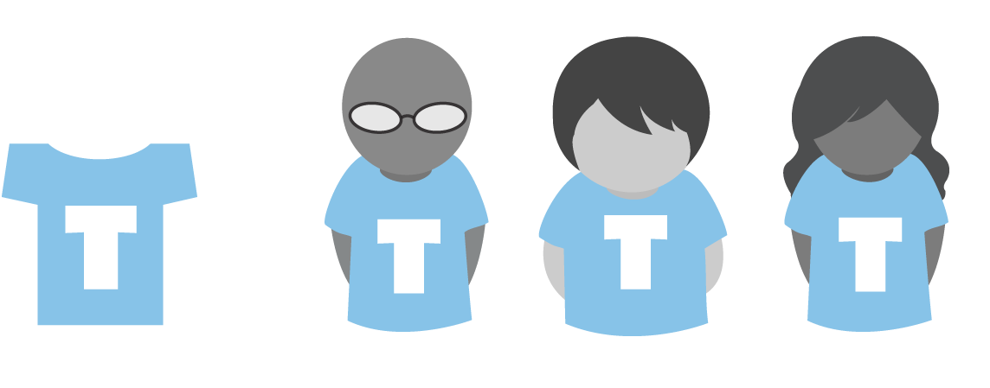
Silverlight 3 New Capabilities : Graphics
Empowering Rich Experiences
Enhanced Control Skinning
Media
Silverlight 3 provides easier skinning capabilities by keeping a common set of styles external from an application. This allows the sharing of styles and control skins between different applications.
Graphics
Graphics
Dev Productivity
Out of Browser
Design Tooling
Notes:
Enhanced control skinning. Silverlight 3 provides easier skinning capabilities by keeping a common set of controls external from an application. This allows the sharing of styles and control skins between different applications.

Slide 26
Silverlight 3 New Capabilities : Graphics
Empowering Rich Experiences
Improved Text Rendering & Font Support
Media
Silverlight 3 provides greatly more efficient rendering and rapid animation of text, and improved clarity through ClearType
Graphics
Graphics
Dev Productivity
Out of Browser
Design Tooling
Notes:
Improved text rendering & font support. Silverlight 3 allows far more efficient rendering and rapid animation of text. Applications also load faster by enabling the use of local fonts.

Slide 27





Silverlight 3 New Capabilities : Dev Productivity
Improving RIA Development Productivity
Controls
Search Discoverability
Media
Graphics
.NET RIA Services Framework
Improved Performance
Dev Productivity
Dev Productivity
Out of Browser
Design Tooling
Advanced Accessibility
Notes:
60+ controls with source code : Silverlight 3 is packed with over 60 high-quality, fully skinnable and customizable out-of-the-box controls such as charting and media, new layout containers such as dock and viewbox, and controls such as autocomplete, treeview and datagrid. The controls come with nine professional designed themes and the source code can be modified/recompiled or utilized as-is. Other additions include multiple selection in listbox controls, file save dialog making it easier to write files, and support for multiple page applications with navigation.

Slide 28
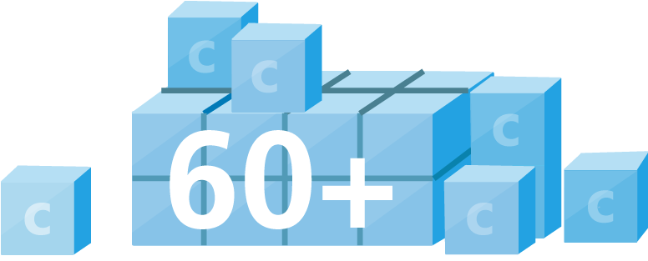
Silverlight 3 New Capabilities : Dev Productivity
Improving RIA Development Productivity
60+ Controls
60+ high-quality, fully skinnable and customizable controls avilable such as charting and media, new layout containers such as dock and viewbox, and controls such as autocomplete, treeview and datagrid. Controls come with nine professional designed themes and the source code can be modified/recompiled or utilized as-is.
Media
Graphics
Dev Productivity
Dev Productivity
Out of Browser
Design Tooling
Notes:
60+ controls: Silverlight 3 is packed with over 60 high-quality, fully skinnable and customizable out-of-the-box controls such as charting and media, new layout containers such as dockpanel and viewbox, and business-ready controls such as autocompletebox, treeview and datagrid. The controls come with nine professional designed themes and most have available source code can be modified/recompiled or utilized as-is. Other additions include multiple selection in listbox controls, file save dialog making it easier to write files, and support for multiple page applications with navigation.

Slide 29

Silverlight 3 New Capabilities : Dev Productivity
Improving RIA Development Productivity
Search Engine Discoverability
Solve the SEO-related challenges posed by RIAs by utilizing business objects on the server, together with ASP.NET controls and site maps, and automatically mirror database-driven RIA content into HTML that is easily indexed by the leading search engines.
Media
Graphics
Dev Productivity
Dev Productivity
Out of Browser
Design Tooling
Notes:
Search Engine Optimization (SEO). Silverlight 3 enables users to solve the SEO-related challenges posed by RIAs. By utilizing business objects on the server, together with ASP.NET controls and site maps, users can automatically mirror database-driven RIA content into HTML that is easily indexed by the leading search engines.

Slide 30

Silverlight 3 New Capabilities : Dev Productivity
Improving RIA Development Productivity
.NET RIA Services Framework
.NET RIA services and a new set of data controls for Silverlight 3 provide a range of new capabilities which make it easier than ever before to build out a complex, data driven user interface. New features include Element to Element Binding, Data Form controls, data validation capabilities, and support for business objects on both the client and server
Media
Graphics
Dev Productivity
Dev Productivity
Out of Browser
Design Tooling
Notes:
Element to Element binding : UI designers use binding between two UI properties to create compelling UI experiences. Silverlight now enables property binding to CLR objects and other UI components via XAML, for instance binding a slider value to the volume control of a media player.
Data Forms. The Data Form control provides support for layout of fields, validation, updating and paging through data.
New features for data validation which automatically catch incorrect input and warn the user with built-in validation controls.
Support for business objects on both client and server with n-Tier data support. Easily load, sort, filter and page data with added support for working with data. Includes a new built-in CollectionView to perform a set of complex operations against server side data. A new set of .NET RIA services supports these features on the server.

Slide 31

Silverlight 3 New Capabilities : Dev Productivity
Improving RIA Development Productivity
Improved Performance
Improvements include Application Library Caching to reduce application size, Enhanced DeepZoom for more fluid navigation with larger DeepZoom collections, Binary XML for compressed and thus speedier communication with the server, and Local Connection which allows communication between two Silverlight applications on the client without server roundtrip
Media
Graphics
Dev Productivity
Dev Productivity
Out of Browser
Design Tooling
Notes:
Improved performance, through:
Application library caching, which reduces the size of applications by caching framework on the client in order to improve rendering performance.
Enhanced Deep Zoom, allows users to fluidly navigate through larger image collections by zooming.
Binary XML allows communication with the server to be compressed, greatly increasing the speed at which data can be exchanged.
Local Connection This feature allows communication between two Silverlight applications on the client-side without incurring a server roundtrip: for instance a chart in one control can communicate with a datagrid in another.

Slide 32

Silverlight 3 New Capabilities : Dev Productivity
Improving RIA Development Productivity
Enhanced Accessibility Support
Silverlight 3 is the first browser plug-in to provide access to all system colors, allowing partially-sighted people to make changes such as high contrast color schemes for ease of readability by using familiar operating system controls.
Media
Graphics
Dev Productivity
Dev Productivity
Out of Browser
Design Tooling
Notes:
Enhanced Accessibility Features. Silverlight 3 is the first browser plug-in to provide access to all system colors, allowing partially-sighted people to make changes such as high contrast color schemes for ease of readability by using familiar operating system controls.

Slide 33






Silverlight 3 New Capabilities : Out of Browser
Out of Browser
Run Apps Out of Browser
Desktop & Start Menu
Media
Graphics
Safer & More Secure
Smooth Installation & Auto Update
Dev Productivity
Out of Browser
Out of Browser
Design Tooling
Windows Integration
Connectivity Detection
Notes:
Silverlight 3 offers a new set of features for building light-weight, sandboxed companion experiences for the Web that run on your desktop. Silverlight out of browser allows websites to build even closer, persistent relationships with customers. We enable you to place your application in a restricted store on the user’s machine; and then provide a link directly to it from the user’s desktop, start menu or Windows 7 superbar. We enable you to do this all within Silverlight 3 without any additional download of runtime or the need to write applications in a different way. You application can now be easily found on the user’s desktop or start menu, and launched with a single click. In addition, it can test if the network is connected, it can update itself, and can also have access to Isolated Storage.
Silverlight out of browser scenarios supported include offline media where you want to play a stored media file for instance on an airplane, data snacking applications such as a twitter client, and light weight web companion .
However, because Silverlight does not allow full access to the machines hardware or API it is not useful for building full desktop applications. Silverlight is a subset of the full .NET platform, so you can also utilize the same code, XAML and project to target a full Windows Desktop application using Windows Presentation Foundation (WPF). This adds significant capabilities such as full access to the local hard drive, support for other hardware such as USB devices, the ability to utilize full hardware acceleration for pixel shaders and 3D graphics, to work with other applications such as Microsoft Office or access to local databases via SQLCE, and support for richer adaptive text.
Microsoft Silverlight provides a way for companies to deploy RIAs to the desktop, creating a closer connection with their customers. With Microsoft Silverlight, your application migrates from being a page that a customer accesses through a web browser, to becoming am out of browser application that provides direct and controlled interactions with your users. In the example above, KEXP is instantly available.
Microsoft Silverlight allows consumers to experience the web in a new way, allowing them to have their favorite web applications and the content with them at all times. Applications are available anytime and anywhere - on the desktop, over the web, on any platform, and on any device. The content is no longer lost on the web when disconnected – it can also be kept locally. More sophisticated applications are now possible that can simply watch network state and decide to cache eg KEXP can utilize cached music when offline. Such features are a must for more mobile computing.
Microsoft Silverlight allows application developers and designers to break free from the browser. In many cases the browser chrome can be a distraction for the user. In particular, in many cases the act of navigating away from a complex application is a weakness of RIA frameworks since data can be lost – by removing these features users can focus on their task without danger.
Microsoft Silverlight out of browser means that an application can become more than a simple bookmark that is one click away from competitors. You can allow your users to place your application on their desktop, or even on their start menu, building a much deeper relationship. They don’t need to search or add favorites to find it again allowing much less friction.
Microsoft Silverlight out of browser allows you to access data when disconnected. Silverlight 3 adds a new API to test network state – for instance KEXP allows the user to download music and upload comments when re-connected.
Because Microsoft Silverlight is a subset of WPF its easy to target a full featured Windows Desktop Application. For instance, KEXP also wants to enable users to keep their music in their MyDocuments folder, and transfer it to other devices. To do this they can take their web companion in Silverlight and add their file and device features using WPF.
Connected applications
Web based applications that rely on network connectivity for their function. These applications can be navigated to from a web page with a click of a hyperlink, and just as easily navigated away from. Silverlight 3 out of browser adds value here in that the user can store their data locally in their Isolated Storage location. An example here would be the ability to download images from a photo-sharing site into Isolated Storage .
Disconnected or Offline applications
These are applications that can function fully well when a network connection is not available. An example here might be a Silverlight application to view media, or read news. Silverlight 3 out of browser enabled this scenario because you can access the local movie file and play it back using Silverlight’s media capabilities. In addition, the desktop features of Silverlight 3 make it easier to find the application, and it can also have a custom chrome.
Occasionally connected applications
These are applications that are expected to be immune to occasional drops in network connectivity. The network awareness feature in Silverlight 3 enabled these to be built; however you will need to do work to make your application more robust, such as building out a data layer that abstracts away features such as web services so that it can indirect to local storage when disconnected – for example cache transactions.
Network awareness
This is the ability to distinguish the current state of network connectivity, and to have knowledge of when this state changes. Silverlight 3 adds a new API to test network state.
Detaching
Detaching or “un-tethering” of an app is the act of the consumer end user in taking the app for out of browser use. You can brand this experience, and Silverlight provides a UI for allowing the user to create a desktop icon and start menu item.
Access to Isolated Storage
Silverlight is fully sandboxed and the clients machine. We have enabled it to write to only a domain specific folder in Isolated Storage and nowhere else on the users hard drive.
Out of browser Application Cache
Every out of browser application has an on-disk representation. Out of browser apps in Silverlight 3 are stored in the Offline Application Cache for the duration they exist on the client machine.
Removing an application
You can have your own branded ‘remove’ or ‘uninstall’ controls; Silverlight also provides a default experience by right clicking on the application and choosing ‘uninstall’

Slide 34

Silverlight 3 New Capabilities : Out of Browser
Out of Browser
Run Applications Outside of the Web Browser
Media
Applications can now be installed and run from the desktop as lightweight web companions, allowing users to take their favorite Web applications with them, regardless of whether they are connected to the Internet or not.
Graphics
Dev Productivity
Out of Browser
Out of Browser
Design Tooling
Notes:
Run outside the browser. Silverlight applications can now be installed to and run from the desktop as lightweight web companions. Thus, users can take their favorite Web applications with them, regardless of whether they are connected to the Internet or not. You no longer need the distraction of the browser chrome.

Slide 35
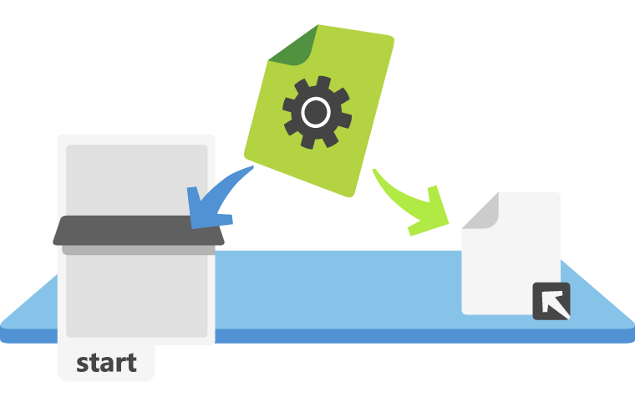
Silverlight 3 New Capabilities : Out of Browser
Out of Browser
Desktop Shortcuts & Start Menu Support
Media
Applications can be stored on the desktop on both Windows and Mac OS, and accessed with one-click from the Start Menu or Applications Folder
Graphics
Dev Productivity
Out of Browser
Out of Browser
Design Tooling
Notes:
Desktop shortcuts and start menu support. Silverlight applications can be stored on any PC or Mac computer’s desktop with links in the start menu and applications folder, and so are available with one-click access. you can place your application on the desktop and be one click away from your customer.

Slide 36

Silverlight 3 New Capabilities : Out of Browser
Out of Browser
Safer & More Secure
Silverlight leverages the security features of the .NET Framework, and runs inside a secure sandbox with persistent isolated storage. As they share most of the security restrictions of traditional web apps, Silverlight apps can be trusted without security warnings or prompts, minimizing user interruptions.
Media
Graphics
Dev Productivity
Out of Browser
Out of Browser
Design Tooling
Notes:
Safe and secure. Leveraging the security features of the .NET Framework, Silverlight applications run inside a sandbox with persistent isolated storage. These applications have most of the same security restrictions as traditional web apps and so can be trusted without security warnings or prompts, minimizing user interruptions.

Slide 37

Silverlight 3 New Capabilities : Out of Browser
Out of Browser
Smooth Installation & Auto-Update
Media
Silverlight applications are stored in a local cache and do not require extra privileges to run, so the installation process is quick and efficient as well as consumer friendly, with support for non-administrator install . Upon launch applications can check for new versions and automatically update themselves.
Graphics
Dev Productivity
Out of Browser
Out of Browser
Design Tooling
Notes:
Consumer friendly non-administrator install Because Silverlight applications are stored in a local cache and do not require extra privileges to run, the installation process is quick and efficient. applications are held in a cache and do not require any privileges to run
Built-in Auto-update. Upon launch, Silverlight applications can check for new versions on the server, and automatically update if one is found. your application will check for new versions on the server and update on launch

Slide 38

Silverlight 3 New Capabilities : Out of Browser
Out of Browser
Windows Support
Take advantage of new Windows 7 capabilities with support for Taskbar pinning and multitouch user input.
Media
Graphics
Dev Productivity
Out of Browser
Out of Browser
Design Tooling
Notes:
Windows integration – on Windows 7 we will support superbar integration, multitouch, and location awareness services such as GPS support so that your application can react to the users location eg for mapping or location targeted information.

Slide 39

Silverlight 3 New Capabilities : Out of Browser
Out of Browser
Connectivity Detection In Browser / Out of Browser
Media
Silverlight applications can now detect whether they have Internet connectivity and can react intelligently including caching a users’ data until their connection is restored.
Graphics
Dev Productivity
Out of Browser
Out of Browser
Design Tooling
Notes:
Connectivity detection. Silverlight applications can now detect whether they have Internet connectivity and can react intelligently including caching a users’ data until their connection is restored.

Slide 40
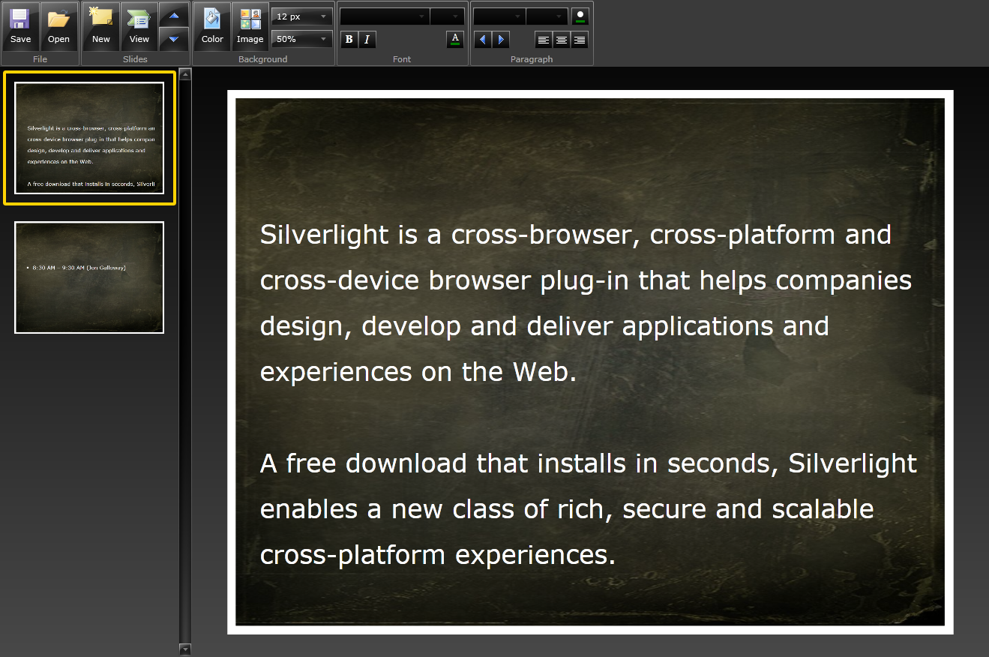
Silverlight 3 New Capabilities : Out of Browser
Out of Browser
Demo
Media
Graphics
Dev Productivity
Out of Browser
Out of Browser
Design Tooling
Notes:
Connectivity detection. Silverlight applications can now detect whether they have Internet connectivity and can react intelligently including caching a users’ data until their connection is restored.

Slide 41

Silverlight 3 New Capabilities : Design Tooling
Designed for Silverlight 3
Media
Graphics
Dev Productivity
Out of Browser
Expression Blend 3 enables developers and designers to take full advantage of the underlying power of the delivery platform. 3D transformations in Silverlight, visual effects such as blur and glow, hardware acceleration, and the Visual State Manager allow the exploration of new design concepts
Design Tooling
Design Tooling
Notes:
New Features in Expression Blend 3 Preview: The designer-developer workflow took another major step forward today with major innovations in Expression Blend 3 including: SketchFlow, a rapid prototyping capability that makes it easy to communicate design intent to stakeholders; design time sample data that enables the design and testing of applications without access to live data; direct import of Adobe Photoshop and Illustrator files; behaviors, extensible and reusable components that add interactivity to applications without writing code; a full code editor supporting C#, VB and XAML; and many more features that support an improved design and development experience

Slide 42




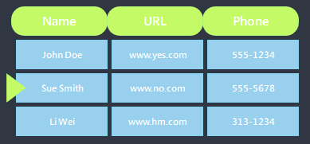


Silverlight 3 New Capabilities : Design Tooling
Breakthrough Design w/ Expression Blend 3
Prototyping w/ SketchFlow
Visual Design Workflow
Media
Graphics
Accessible Interactivity
Design w/ Data
Dev Productivity
Out of Browser
Design Tooling
Design Tooling
VSTF Integration
Design Surface Extensibility

Slide 43
Silverlight 3 New Capabilities : Design Tooling
Breakthrough Design w/ Expression Blend 3
Breakthrough Design Prototyping
SketchFlow introduces a new set of innovative features for the rapid prototyping of user experiences. SketchFlow helps designers rapidly explore the navigation and composition of an application using visual tools without the need for coding, to communicate ideas to other stakeholders, and to collect in-context annotated feedback.
Media
Graphics
Dev Productivity
Out of Browser
Design Tooling
Design Tooling
Start
Navigation
Main Menu
Data Entry
Notes:
SketchFlow. SketchFlow introduces a new set of features designed to make it easier for you to experiment with dynamic user experiences and create compelling prototypes. SketchFlow also helps communicate design ideas to other stakeholders, and makes it easier to collect in-context annotated feedback. SketchFlow enables the navigation and composition of an application to be modeled in a very visual manner from a simple prototype that uses a series of sketches, to something much more evolved. A prototype can be made as real and interactive as it needs to be to communicate design intent and SketchFlow can leverage all the existing features of Expression Blend.

Slide 44



Silverlight 3 New Capabilities : Design Tooling
Breakthrough Design w/ Expression Blend 3
Visual Design Workflow
Adobe Photoshop and Illustrator import enables integration with existing workflows, with full support for individual layers which retain their original layer effects, layout, editable text, and vector content.
Media
Graphics
Dev Productivity
Out of Browser
Design Tooling
Design Tooling
Notes:
“Importing from Adobe Photoshop and Adobe Illustrator. Expression Blend contains powerful import tools to enable smooth integration with workflows the designer already has in place. Designers can import files in both Adobe Photoshop and Adobe Illustrator file formats. The designer has freedom to view and import Photoshop files layer by layer. Layers can be easily regrouped and elements retain their original formats; layers, layer positions, editable text and vectors remain available for editing within Expression Blend.”

Slide 45
Silverlight 3 New Capabilities : Design Tooling
Breakthrough Design w/ Expression Blend 3
Accessible Interactivity
Add interactivity to applications without having to write code using Behaviors, which encapsulate complex design interactions into reusable components which can be directly applied to a user interface element in the application.
Media
Graphics
Dev Productivity
Out of Browser
Behave
Design Tooling
Design Tooling
Notes:
Behaviors. Add interactivity to your application, without having to write code. Behaviors can encapsulate complex design interactions into reusable components which can be directly applied to a user interface element in the application. Developers have access to a rich API that they can use to write their own triggers, actions, and behaviors for use in their Silverlight and WPF projects.

Slide 46
Silverlight 3 New Capabilities : Design Tooling
Breakthrough Design w/ Expression Blend 3
Design with Data
Design time Sample Data makes it easy to design data-connected applications without access to live data, and with fast and easy generation of “dummy” placeholder data.
Media
Graphics
Dev Productivity
Name
URL
Phone
Out of Browser
John Doe
www.yes.com
555-1234
Design Tooling
Design Tooling
Sue Smith
www.no.com
555-5678
Li Wei
www.hm.com
313-1234
Notes:
Sample data. Design time sample data makes it easy to build data-connected applications without access to live data. You can generate sample data or import sample data from an XML file and is available to controls on the artboard at design-time. You can extensively customize your sample data details, and you can easily switch between using sample data and using live data at run-time.

Slide 47

Silverlight 3 New Capabilities : Design Tooling
Breakthrough Design w/ Expression Blend 3
Source Control Integration w/ VS Team Foundation Server
Media
Teams can access Team Foundation Server directly from Expression Blend ensuring they can collaborate effectively with the rest of the team; work is versioned, tracked, backed-up and above all safe.
Graphics
Dev Productivity
Out of Browser
Design Tooling
Design Tooling
Notes:
. Team Foundation Server support allows easier integration of the Blend user into Team System

Slide 48

Silverlight 3 New Capabilities : Design Tooling
Breakthrough Design w/ Expression Blend 3
Design Surface Extensibility
Custom project and item templates, custom context menu items, custom adorners on the design surface when a designer selects a custom component, and enhanced support for VS2010 extensibility APIs all help provide a fluid design and development environment
Media
Graphics
Dev Productivity
Out of Browser
Design Tooling
Design Tooling
Notes:
Extensibility framework now enables 3rd parties to build on Expression Blend

Slide 49
But, why?
HTML/Javascript or Silverlight?
YES!
Use the best tool for the job
Silverlight benefits in application development
.NET Development / Debugging / Maintenance
Performance (code, graphics)
More advanced experiences, often simpler code
RIA Services - http://code.msdn.microsoft.com/RiaServices
Media applications
(just a few examples)
Developer / Designer workflow

Slide 50
Summary

Slide 51
Pete Brown is cool
http://community.irritatedvowel.com/blogs/pete_browns_blog/archive/2009/04/30/Silverlight-3-Links-from-the-Reston-DevDinner.aspx
http://timheuer.com/blog/archive/2009/09/29/seattle-firestarter-videos-available-online.aspx

